Slide 1


Thermal Imaging System
www.vonetec.com
IT Specialist for Cruising and Shipping
05/22/2020
v1.0

Slide 2

Outbreak of the coronavirus
High fever
is
One of the symptoms
05/22/2020 v1.0
Copyright: VONE Technology, all rights reserved

Slide 3




Passenger’s temperature measurement
If check in 3,000 or 5,000 passengers
We need a powerful system
05/22/2020 v1.0
Copyright: VONE Technology, all rights reserved

Slide 4
VONE TSS
Stable and reliable when sailing
Processing fast with high accuracy
System available when cruising
Historical data tracking and tracing
Easy operating, no specialist required
Other features (API)
05/22/2020 v1.0
Copyright: VONE Technology, all rights reserved

Slide 5

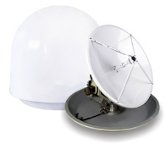

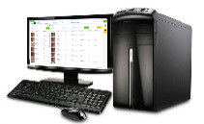
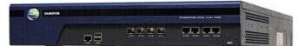
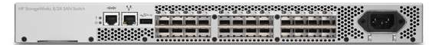



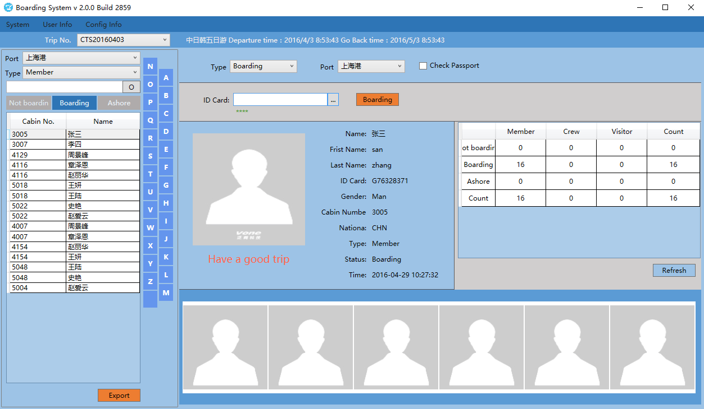

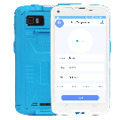

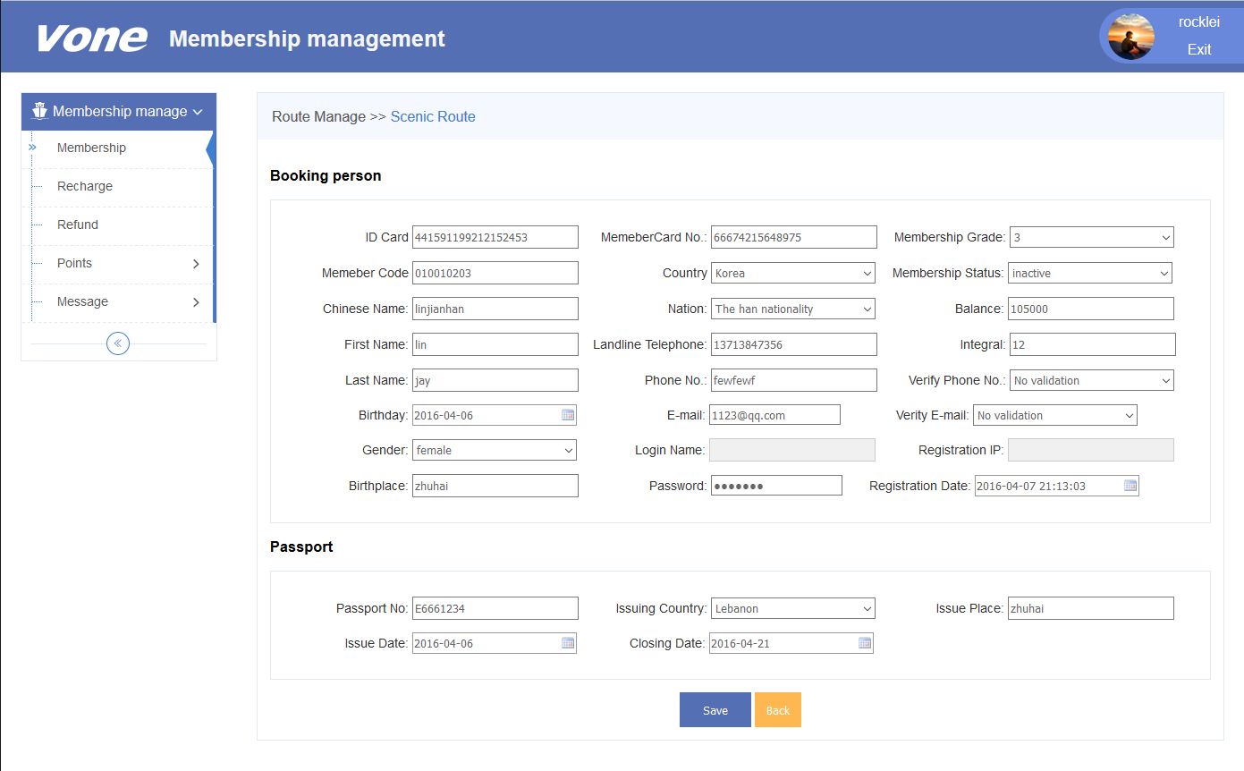

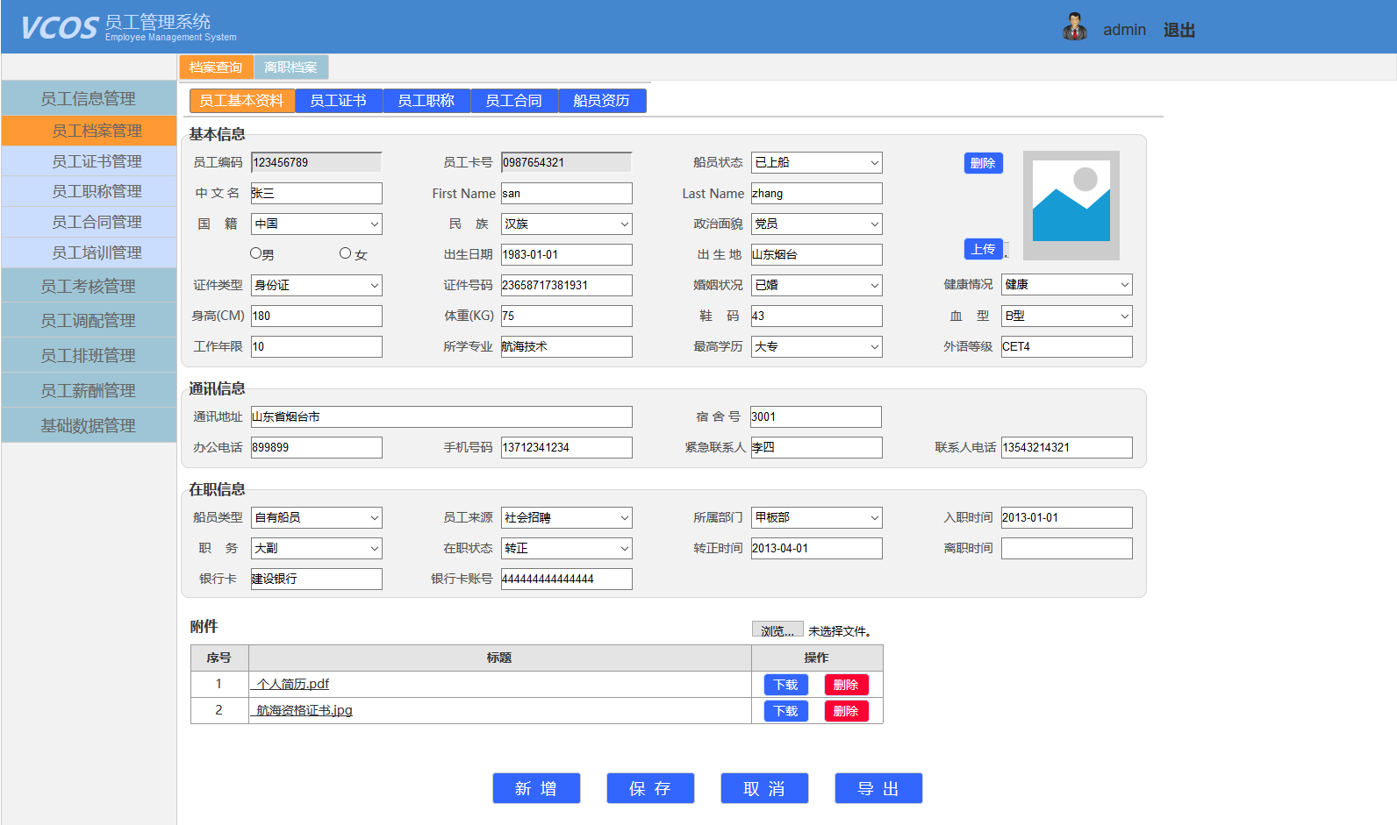
System structure (existing / new deploy)
1000M
Onshore, offshore sync
Data traffic
Cloud server
Mobile device
PC
Network switch
Embarkation system
Fixed thermal imaging camera
Ceiling/Wall mounting
Fixed thermal imaging camera + tablet
Wall/Pole mounting
AI server
VCOS thermal imaging core system
(Virtual Machine)
Mobile tablet
Thermal scan
Medical system
Mobile thermal imaging camera
PMS
5
05/22/2020 v1.0
Copyright: VONE Technology, all rights reserved

Slide 6
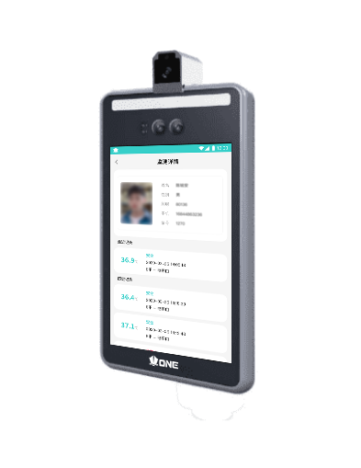
Technical details of Thermal Imaging tablet
Product name | Thermal imaging tablet (VPAD L01T) Face recognition （wall mount, pole stand）
specification | Main feature | Thermal imaging Face recognition HR Attendance
 | Install location | Entry of crew mess Crew bar or medical centre
 | mode | Stand in front of the camera within 30cm
 | environment | indoor
 | installation | Wall mount, pole stand
Thermal imaging | measurement | forehead
 | temperature | 16℃~40℃
 | distance | ≤0.3m
 | accuracy | ±0.3℃
 | NETD | 0.1℃
Protocol | Stand-alone or network, wire or wireless
For the crew to measure
their temperature twice
a day when they clock in
and clock out
Integrate with the ship
attendance system
05/22/2020 v1.0
Copyright: VONE Technology, all rights reserved

Slide 7
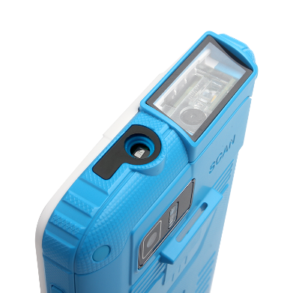
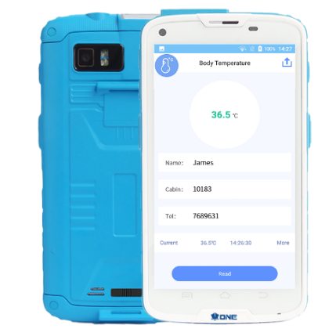
Technical details of Thermal imaging mobile
Product name | Thermal imaging mobile VPAD A01T（app + scanner）
specification | Main feature | Thermal imaging Barcode scanner QRcode scanner NFC, IC chip reader
 | Install location | Mobile device anywhere
 | system | Android
 | environment | Indoor + outdoor
 | installation | handheld
Thermal imaging | measurement | Forehead temperature
 | temperature | 10℃~40℃
 | distance | ≤0.1m
 | accuracy | ±0.3℃
 | NETD | 0.1℃
Protocol | 3G / 4G / WiFi
When SOP activated,
medical staff needs to
doublecheck the
passenger’s temperature
Security guard check
visitors’ temperature
05/22/2020 v1.0
Copyright: VONE Technology, all rights reserved

Slide 8
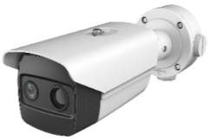
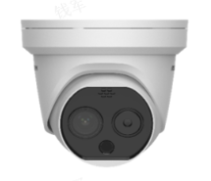
Thermal imaging camera
 | Thermal camera (wall mount)
specification | Thermal resolution | 160 × 120
 | Focal length | customization
 | Field of view | 15.96°×12°
 | Optical resolution | 2688*1520
 | Focal length | Adjust by onsite condition
 | Picture in picture | Combine the details of thermal and optical picture
 | Video compression | H.265/H.264/MJPEG
 | Protocal | IPv4/IPv6, HTTP, HTTPS etc
 | Alarm | Input and output
 | Thermal camera (ceiling mount)
specification | Thermal resolution | 160 × 120
 | Focal length | customization
 | Field of view | 25°×18.7°
 | Optical resolution | 2688*1520
 | Focal length | Adjust by onsite condition
 | Picture in picture | Combine the details of thermal and optical picture
 | Video compression | H.265/H.264/MJPEG
 | Protocal | IPv4/IPv6, HTTP, HTTPS etc
 | Alarm | Input and output
Deploy at cruise terminal, gangway entry, reception lobby, etc.
05/22/2020 v1.0
Copyright: VONE Technology, all rights reserved

Slide 9
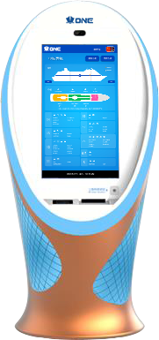
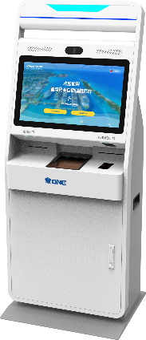
Self check in system - kiosk
Product name | Self check in system - kiosk
specification | System | Windows operating system
 | scanner | Barcode, Qrcode Passport scanner
 | screen | Touch screen
 | printer | Thermal printer
 | customization | yes
Thermal imaging | measurement | forehead
 | temperature | 10℃~50℃
 | distance | ≤0.3m
 | accuracy | ±0.3℃
 | NETD | 0.1℃
Protocol | IPv4 / IPv6 network, wire or wireless
Deploy at cruise
terminal for the passenger
self service of check-in
Scan their passport
Take temperature
Print out the boarding pass
Customizable
05/22/2020 v1.0
Copyright: VONE Technology, all rights reserved

Slide 10
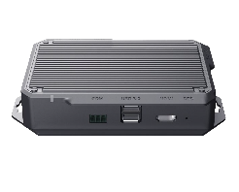

Thermal imaging camera
 | AI Server
specification | Face recognition accuracy rate | >99% >90% (wearing mask)
 | Processing speed | 12 photo / second
 | Camera | Up to 4 thermal camera
 | Photo capacity | 300,000
 | CPU/GPU | ARM / Edge
 | RAM / Storage | 8GB / 64GB
 | Network | Gbit Eth x 2 ( 1 for PoE)
 | System | Linux
 | Power | AC 100v-240v / DV12v
 | Thermal Imaging (VCOS TSS Core system)
specification | server | Physical server or VM
 | Implementation | Easy, low hardware requirement
 | user | Multiple user access privilege configuration
 | Search | By uploading a photo, by time, by location
 | Data privacy | Private information protecting
 | Open API | Standard API will allow third party system to connect
 | Alarm trigger | By screen flash, lights, email
 | Big data | Historical record tracking and close contact tracing
 | System update | System update regularly
05/22/2020 v1.0
Copyright: VONE Technology, all rights reserved

Slide 11
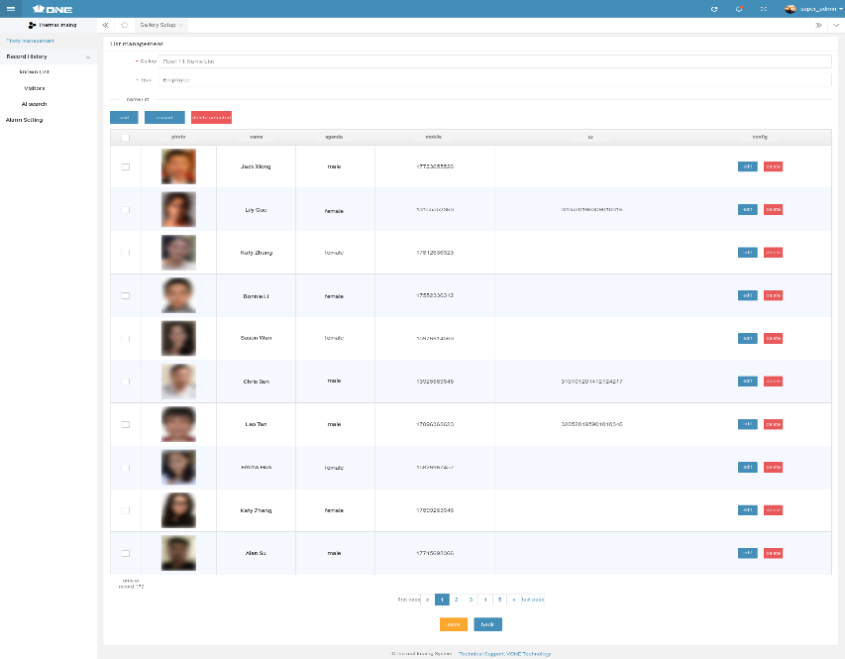
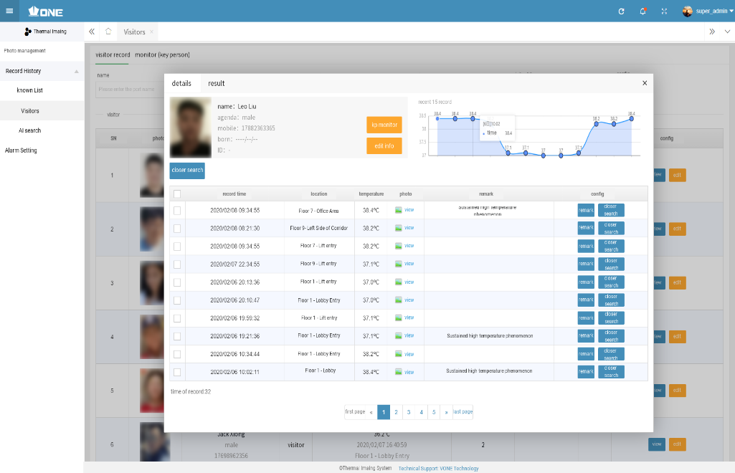
Technical advantages
Face recognition accuracy rate >99%
Temperature measurement deviation ≤0.3℃
Fast processing speed, 12 photo/second
AI Search, by photo, by time, by location
Standard API: Attendance, PMS, Medical
Central database management link to multiple cameras
No additional disturbance to passengers, no additional staff required, reduce the risk of cross infection
Fast implementation, high reliability, easy operation
Multiple languages, report customization
05/22/2020 v1.0
Copyright: VONE Technology, all rights reserved

Slide 12
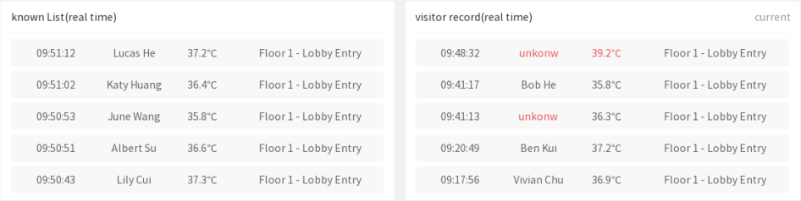
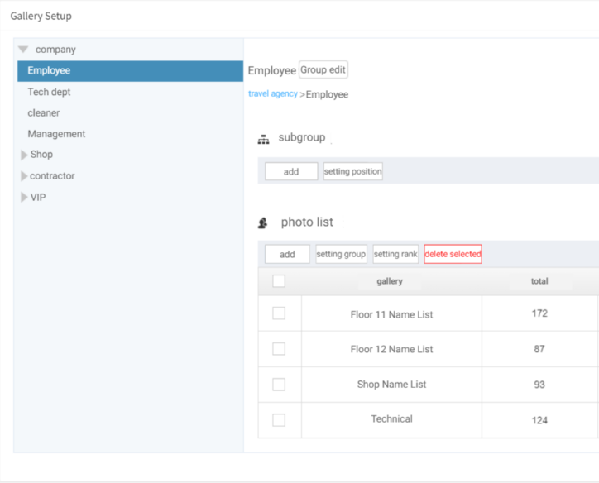
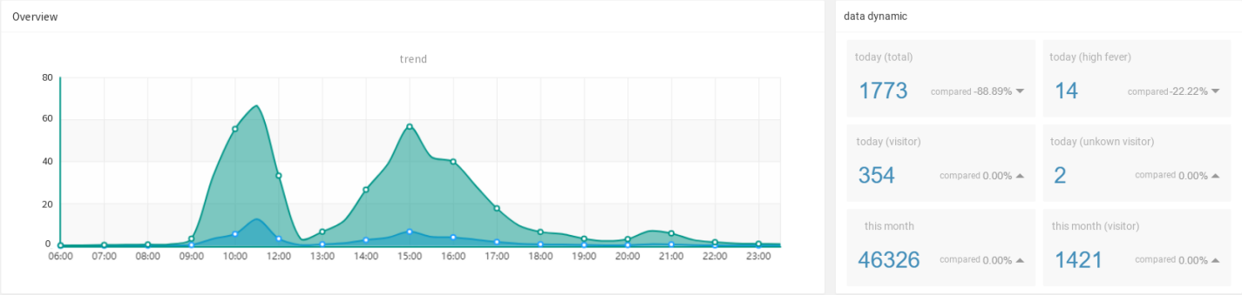
Technical advantages
User access privilege management
Group management (passenger, crew)
Temperature history tracking
Close contact tracing (on/off)
Email notification
05/22/2020 v1.0
Copyright: VONE Technology, all rights reserved

Slide 13
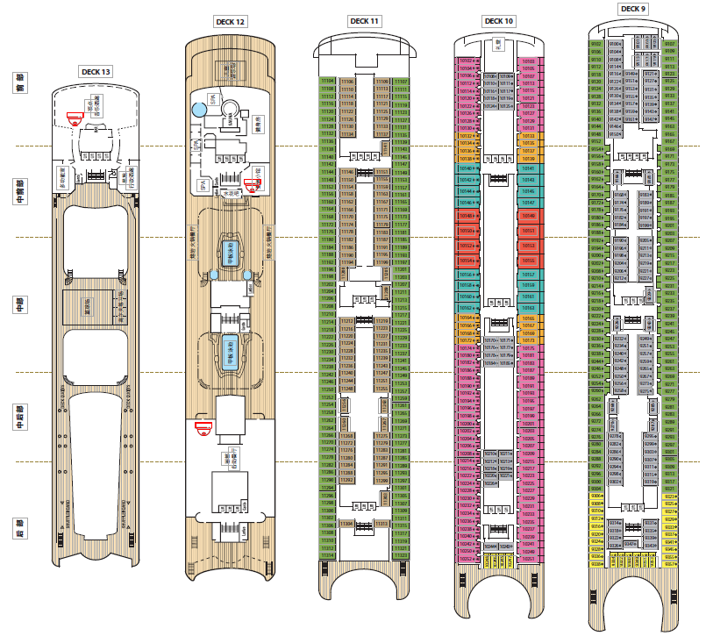
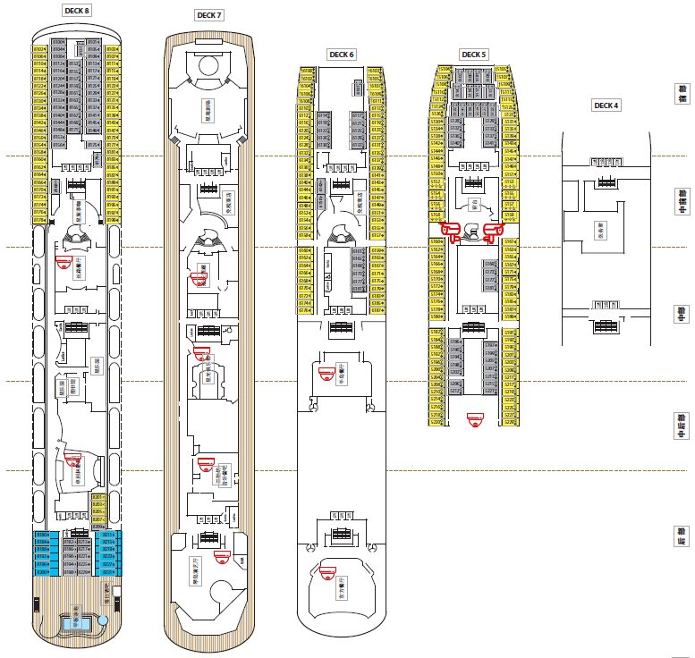
System implementation - example
SN | Equipment | Qty | unit | remark
1 | Thermal imaging camera | 6 | set | Will be deployed at below location： DK6 entry of restaurant A & restaurant B DK7 entry of the theatre, etc DK8 entry of library DK12 reception lobby & corridor
2 | Mobile thermal imaging camera | 2 | set | Gangway，two mobile thermal imaging cameras for passenger embarkation.
3 | AI Server | 2 | set | Facial recognition, Mask wearing recognition, photo taking and temperature recording, etc
4 | AI Tablet | 4 | pc | Crew temperature measurement
5 | Mobile (Android) | 4 | set | For the medical staff and security guard.
6 | VCOS TSS core system | 1 | set | Can be installed on physical server or VM
7 | Thermal reference source | 2 | pc | Optional, (recommended for the gangway camera)
Illustration purpose
Remark：
1. Network will be done by ship operator, VONE Technology install the thermal imaging system
2. The location of each camera installation will be decided after site-survey.
3. System can be easily expanded when required.
13
05/22/2020 v1.0
Copyright: VONE Technology, all rights reserved

Slide 14
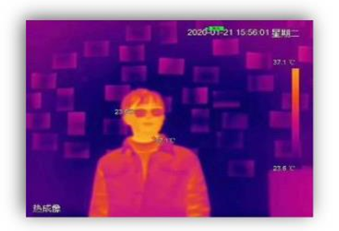
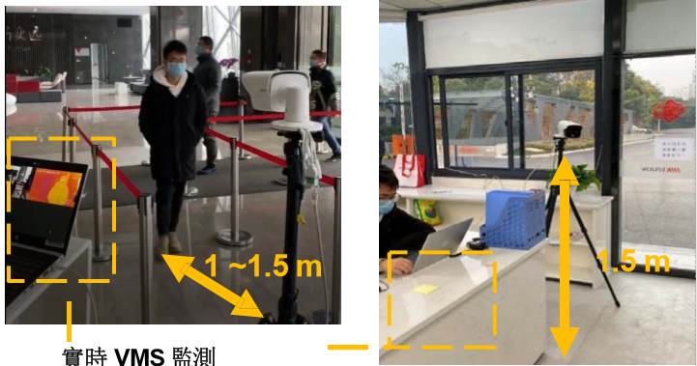
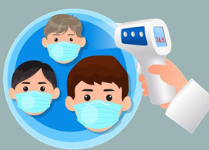
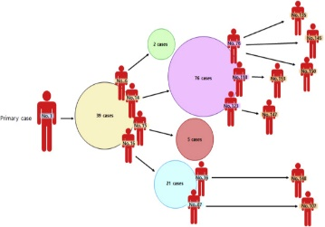
Embarkation – Traffic Flow
Thermal
Imaging
Alert
Triggered
SOP
Activated
Recording
Tracing
Contactless, Fast
if abnormal temperature detected
SOP will be activated
Backend system recording
remote，crowd
further screening will be arranged
Privacy Policy
Close contact tracing (on/off)
05/22/2020 v1.0
Copyright: VONE Technology, all rights reserved

Slide 15
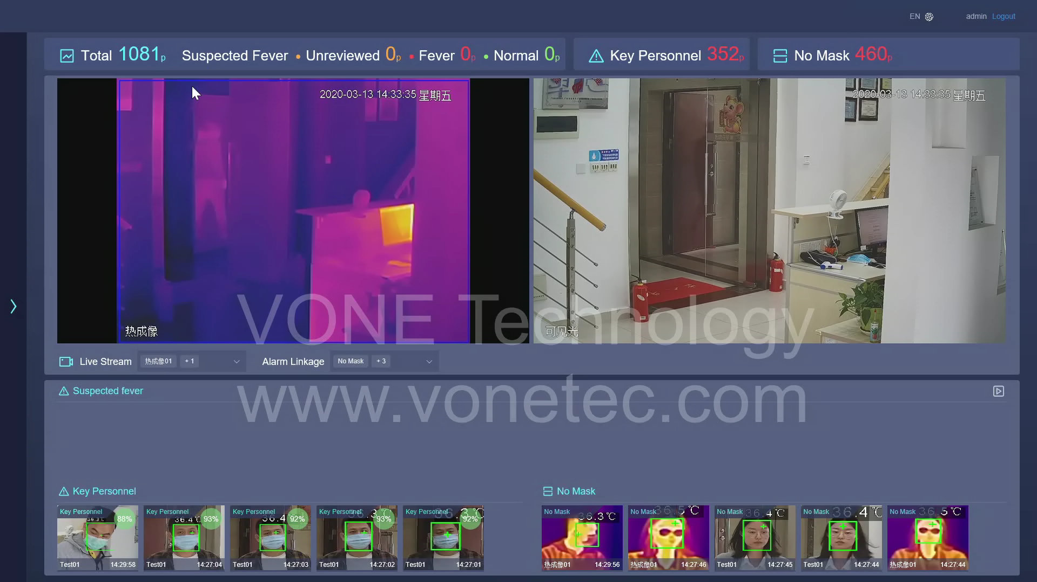
Demo
Visit
webpage
05/22/2020 v1.0
Copyright: VONE Technology, all rights reserved

Slide 16
Thank you
Contact us
Singapore：VONE Technology Pte Ltd
China：VONE Technology Co., Ltd.
Tel：(+65) 8660 3978
Tel：(+86) 0756 8983833
Web：www.vonetec.com
Web：www.vonechina.com
E-mail：vone@vonetec.com
E-mail：vone@vonechina.com
Add：18 Howard Road, #10-05
Add：Room2201, SENYU International Building
Novelty Bizcentre, Singapore
CUIQIAN Northroad, New XIANGZHOU, ZHUHAI
05/22/2020 v1.0
Copyright: VONE Technology, all rights reserved

